Slide 1








Type here
[Comic Strip Title]
Type here
Type here
By [Name]
Type here
[Episode Title]
Type here
[Insert Tagline]
Type here
Type here
Type here
SLIDE 1: TITLE PAGE
Comic Title: [Insert Your Comic Title]
Author: [Your Name]
Story Inspiration: Modern Adaptation of "The Gift of the Magi"
Visuals:
• Include an image or symbol that represents your story.
• Show the main characters or an important object from the story.
Dialogue/Narration:
• Optional subtitle or tagline that hints at the theme.
Example:
"Sometimes the greatest gifts come from sacrifice."

Slide 2
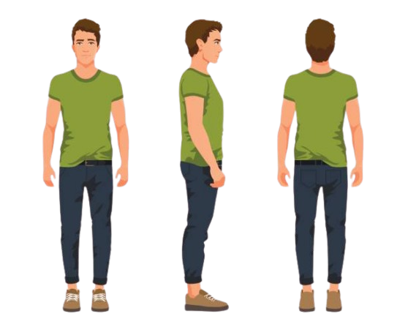

Type here
Type here
Type here
Type here
Type here
Type here
Type here
Type here
Type here
Type here
SLIDE 2: INTRODUCTION / SITUATION
Setting Description:
[Describe where and when your story takes place.]
Major Character Introduction:
[Character A] and [Character B] are _______________.
Relationship:
They are _______________.
Challenge:
The characters want to give each other meaningful gifts, but they face the problem of _________________.
Motivation:
Why are the gifts important to them?
Visuals:
• Show the setting.
• Introduce both characters.
• Include clues about the special possessions they value.
Dialogue/Narration:
[Character A]: ""
[Character B]: ""

Slide 3
Type here
Type here
Type here
Type here
Type here
Type here
Type here
Type here
SLIDE 3: CHARACTER A'S SACRIFICE
Character A's Important Possession:
Reason for the Sacrifice:
Character A wants to buy __________________________ for Character B.
Sacrifice:
To get enough money, Character A decides to __________________________.
Feelings:
How does Character A feel about making this sacrifice?
Visuals:
• Show Character A giving up something valuable.
• Show Character A purchasing the gift.
Dialogue/Narration:
[Character A's Thought Bubble]:
"___________________________________"

Slide 4
Type here
Type here
Type here
Type here
Type here
Type here
Type here
Type here
Character B's Important Possession:
___________________________________________________________
Reason for the Sacrifice:
Character B wants to buy __________________________ for Character A.
Sacrifice:
To get enough money, Character B decides to __________________________.
Feelings:
How does Character B feel about making this sacrifice?
___________________________________________________________
Visuals:
• Show Character B giving up something valuable.
• Show Character B purchasing the gift.
Dialogue/Narration:
[Character B's Thought Bubble]:
"___________________________________"

Slide 5
Type here
Type here
Type here
Type here
Type here
Type here
Type here
Type here
Gift Exchange Scene:
Describe where the characters meet and exchange gifts.
___________________________________________________________
Suspense:
What are the characters expecting to happen?
___________________________________________________________
Visuals:
• Show both characters together.
• Show the wrapped gifts.
• Build anticipation before the gifts are opened.
Dialogue/Narration:
[Character A]: "I got something special for you."
[Character B]: "I can't wait for you to see yours!"

Slide 6
Type here
Type here
Type here
Type here
Type here
Type here
Type here
Type here
The Discovery:
What do the characters learn after opening the gifts?
___________________________________________________________
Irony:
Explain how each sacrifice made the other's gift unusable,
unnecessary, or less useful.
___________________________________________________________
Character Reactions:
How do the characters feel when they realize what happened?
________________________________________________________
Visuals:
• Show the gifts being opened.
• Show surprised or shocked reactions.
• Highlight the ironic outcome.
Dialogue/Narration:
[Character A]: "Wait... you sold your __________?"
[Character B]: "And you gave up your __________?"

Slide 7
Type here
Type here
Type here
Type here
Type here
Type here
Type here
Type here
Resolution:
How do the characters respond to the situation?
___________________________________________________________
Theme:
What lesson do they learn about love, friendship, loyalty,
or generosity?
___________________________________________________________
Character Growth:
How have the characters changed or what have they realized?
___________________________________________________________
Visuals:
• Show the characters together.
• Emphasize their relationship rather than the gifts.
• Create a positive ending.
Dialogue/Narration:
[Narrator]:
"___________________________________"
Final Theme Statement:
___________________________________________________________

Slide 8
Scaffolded Template

